Slide 1
ICU Mortality Prediction Modelling using MIMIC-III database
János Kondri

Slide 2
Source Dataset
Source: MIMIC-III Database Demo – 4 tables retrieved
ADMISSIONS, PATIENTS, ICUSTAYS, LABEVENTS
Raw data: 129 admissions = > 100 patients
Inclusion criteria
Age data available
Lactate recorded within first 24 hours of ICU admission
69 patients remained after exclusion

Slide 3
Predictor Variables
Mortality prediction was chosen due to ease of interpretation for outcome, as well as neat application to ICU function as KPI (e.g.: number of deaths)
Predictor Variables
Variable | Source | Data Type | Rationale for use
Date of Birth | [PATIENTS](DOB) | Datetime | Calculating age at the time of hospitalization
Serum Lactate Measurement | [LABEVENTS](LABEVENTS) - > itemid 50813 | Numerical | Lactate level has been connected to mortality in ill patients within clinical settings
Outcome Variable
Variable | Source | Data Type | Rationale for use
Mortality | [ADMISSIONS](HOSPITAL_EXPIRE_FLAG) | Boolean Value (represented as 0 or 1) | Mortality represents if death occurred or not during hospitalization

Slide 4
Model Choice
Algorithm: Binomial logistic regression [glm() function]
Formula: hospital_expire_flag ~ lactate + age
Training/Testing data: 70/30 split

Slide 5
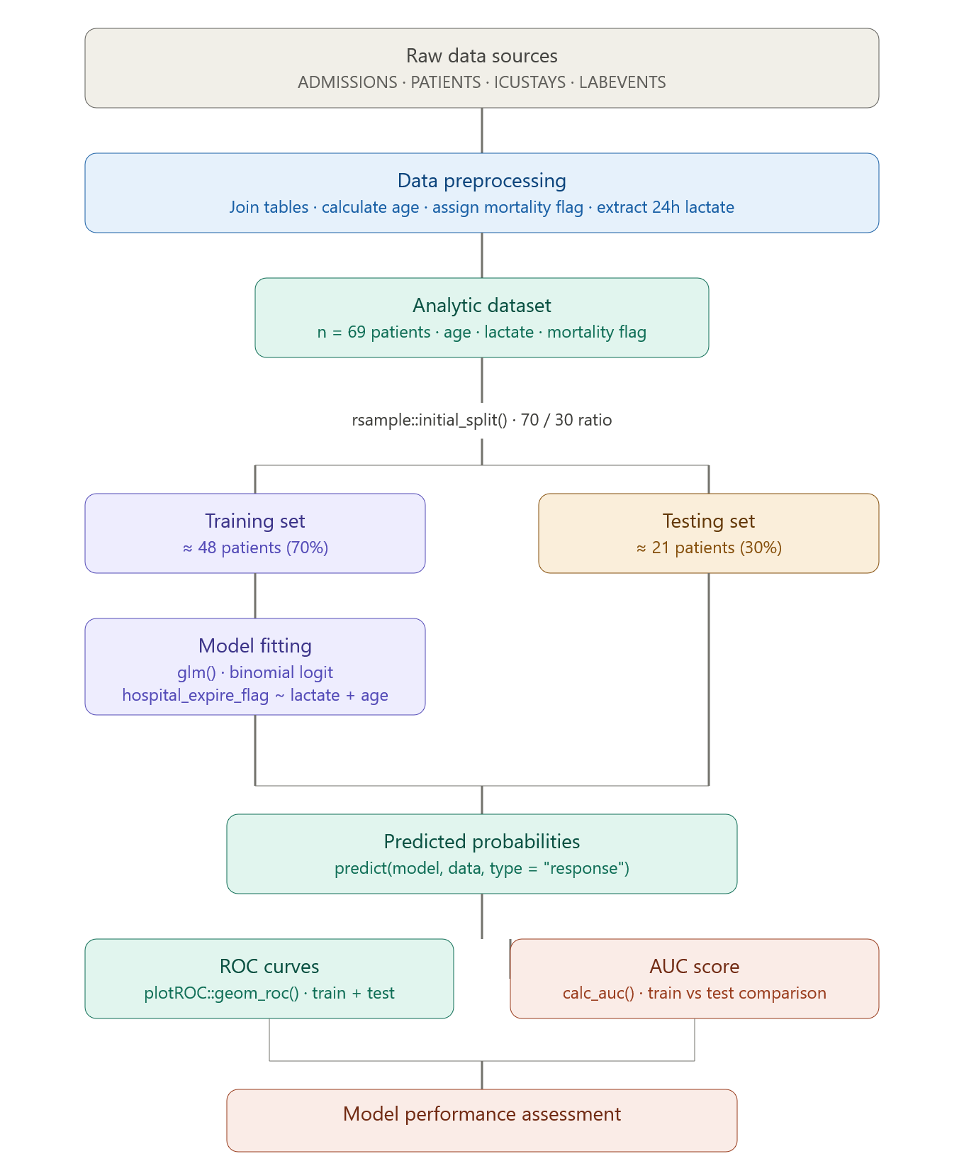
Processing Pipeline

Slide 6
Model Performance Metrics
Predictor significance
Lactate: estimate 0.93, p = 0.009 — statistically significant ✓
Age: estimate 0.007, p = 0.586 — not statistically significant ✗
Model fit
Null deviance: 56.77 → Residual deviance: 41.19
Reduction of 15.6 points — meaningful improvement over null model
Discrimination (AUC = > Area Under the Curve)
Training AUC: 79.4% — acceptable performance
Testing AUC: 59.1% — poor generalisation
20.3% gap indicates overfitting

Slide 7
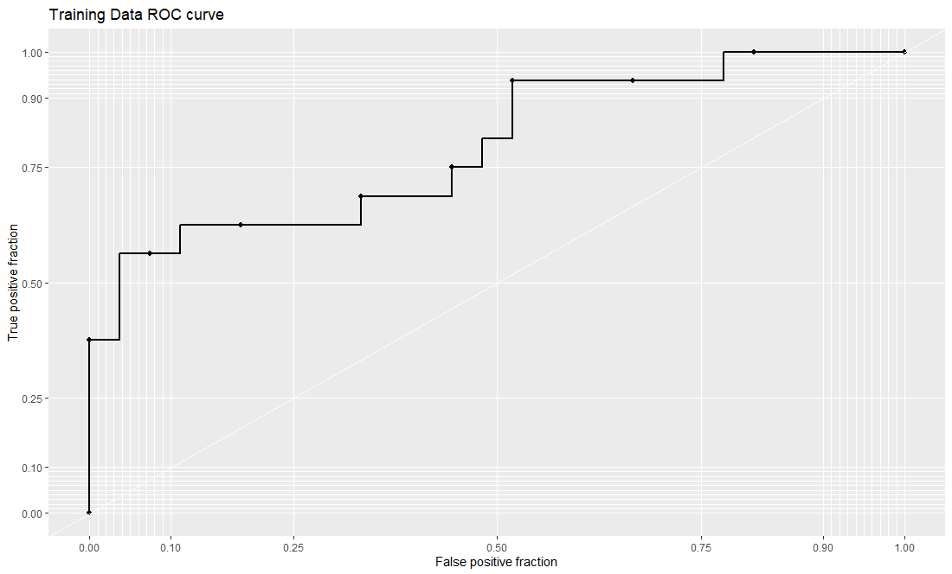
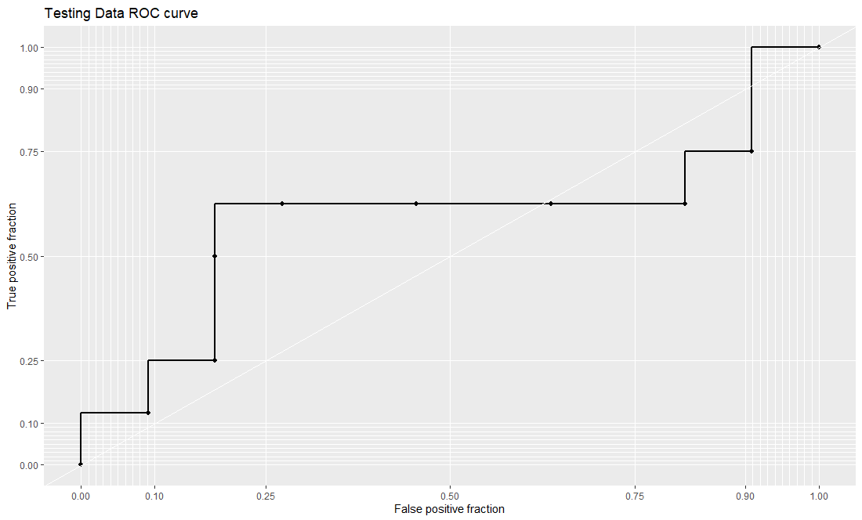
Model Performance Metrics
Training AUC:
79.4%
Testing AUC:
59.1%

Slide 8
Model Discussion
Current model is flawed, not suitable for clinical use due to poorer mortality (AUC value) within the testing dataset
Lactate serum level plays significant role in Mortality prediction (p < 0.05), while Age did not (p > 0.05)
Low sample size for training and testing population for the model
Model prone to overfitting within non-training data
70/30 split for training split is simple and has limitations in reproducability and AUC estimation

Slide 9
Reflections & Takeaways
Serum lactate level found to be suitable predictor, as literature also suggests
Modelling pipeline was implemented in a clean and reproducible manner
Initial training metrics indicate good prediction model for mortality
Single data for testing from the MIMIC-III dataset demo limits the data population
Further refinement would be needed for mortality prediction
Possible testing and implementation of other prediction variables for more robust predictions

